Slide 1
Applied Web Development w/ PHP
Trevoir Williams

Slide 2
Course Objectives
Basic Web Development with HTML and CSS
Setup XAMPP Server
Understand the role of PHP in Web Based Programming Applications.
How to Build a Database using PHPMyAdmin
Build Data Driven and Dynamic Web Applications
How to manipulate data using PHP PDO
How to Use Bootstrap Framework
How to Use GitHub for Source Control
How to Deploy a Web Application using Heroku

Slide 3

What is PHP
Short for Hypertext Preprocessor (or Personal Homepage)
Open Source Server Side Web Scripting Language
Used for web development and is designed to be embedded in HTML
Inserted using special tags <?php … ?>
Similar to other high level languages like C++/C#/Java

Slide 4

What is XAMPP Server
XAMPP is the most popular PHP development environment
XAMPP is a completely free
Includes
Apache Server
MariaDB and MySQL
PHP and Perl
Open source package has been set up to be incredibly easy to install and to use.

Slide 5
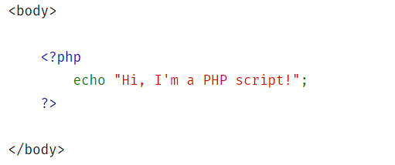
HTML/CSS and PHP
PHP files use an extension .php
.php files can have regular HTML but allow you to insert PHP tags and code blocks

Slide 6

What is Source Control (GitHub)
Source or Version Control is a system that records changes to a file or set of files over time so that you can recall specific versions later
GitHub brings teams together to work through problems, move ideas forward, and learn from each other along the way.
Allows you to
Track Changes to your project
Collaborate with a team member
Centrally host your code for your team
Manage project documentation

Slide 7

Deploying to the Internet (Heroku)
Deploy PHP in minutes
Host a PHP Web Application and Database
Scale automatically
Free Plan Available

